Slide 1

CSA0808-PYTHON PROGRAMMING
Air Quality Prediction Using Environmental Data Analytics
Supervised by
Dr. Ponmaniraj
Presented by
M. Sanjay Krishna(192525421)
K. Jaswanth(192524455)
R. Makeshwaran (192519082)

Slide 2


Abstract
Air pollution has become a major environmental issue affecting human health and climate conditions. This project focuses on predicting air quality using environmental data analytics techniques. The system collects pollution-related data such as temperature, humidity, CO₂, PM2.5, and PM10 levels. Machine learning and deep learning algorithms like Random Forest and LSTM are used to analyze historical data and predict Air Quality Index (AQI). The proposed system improves prediction accuracy and helps authorities monitor pollution levels effectively.

Slide 3
Introduction
Air pollution is increasing rapidly.
Vehicle emissions and industries cause pollution.
AQI indicates pollution severity.
AI techniques help predict future AQI levels.
Environmental analytics improves monitoring systems.
Early prediction helps public safety.

Slide 4
Objectives
Collect environmental pollution data.
Analyze air quality parameters.
Predict AQI accurately.
Use LSTM and Random Forest algorithms.
Improve environmental monitoring.
Reduce pollution-related risks.

Slide 5
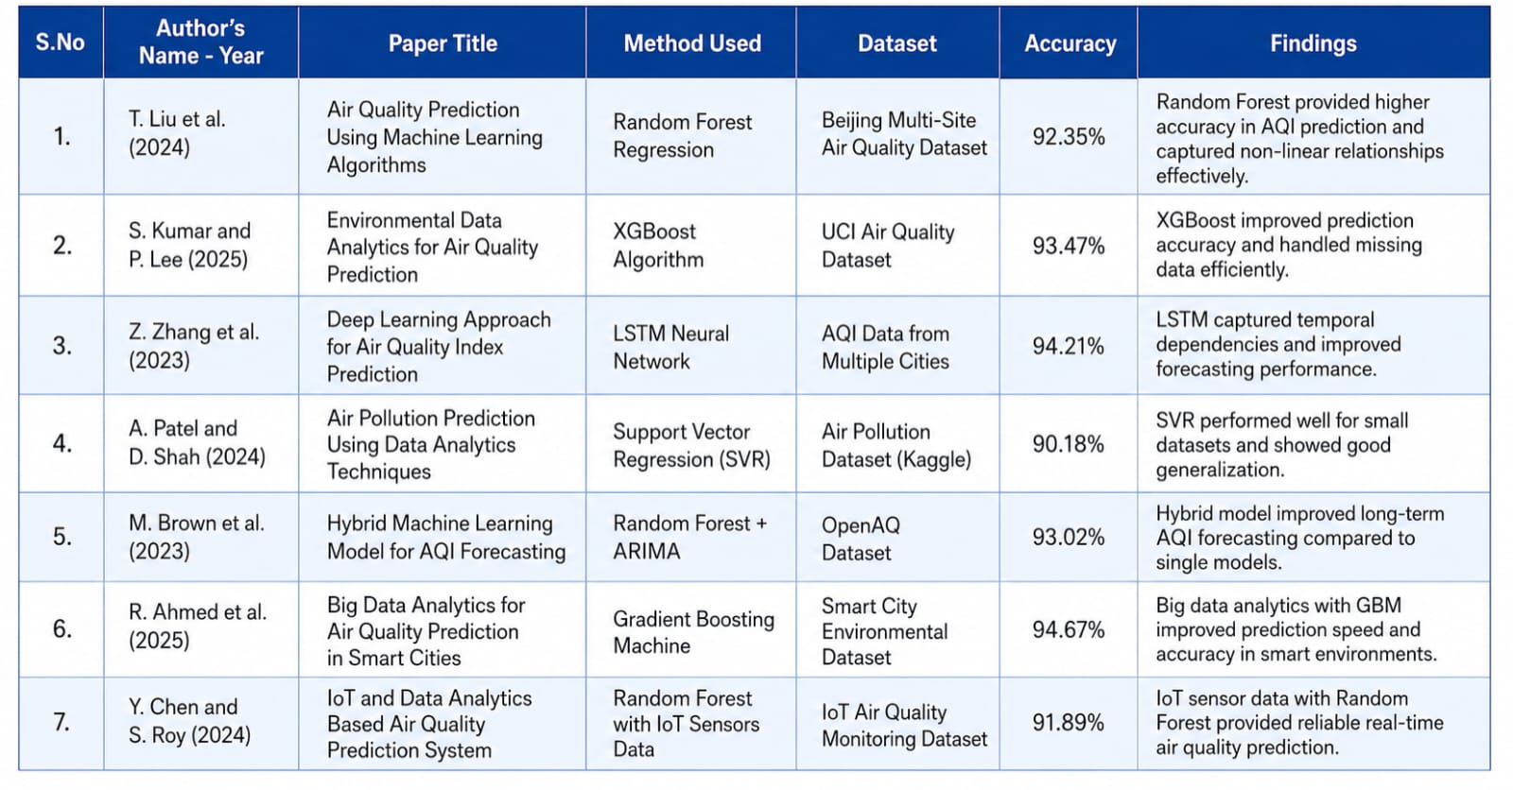
Literature Survey

Slide 6
Problem Statement
Air pollution causes health issues.
Existing systems provide less accurate predictions.
Real-time AQI forecasting is difficult.
Large environmental datasets are hard to analyze.
Intelligent prediction systems are required.

Slide 7
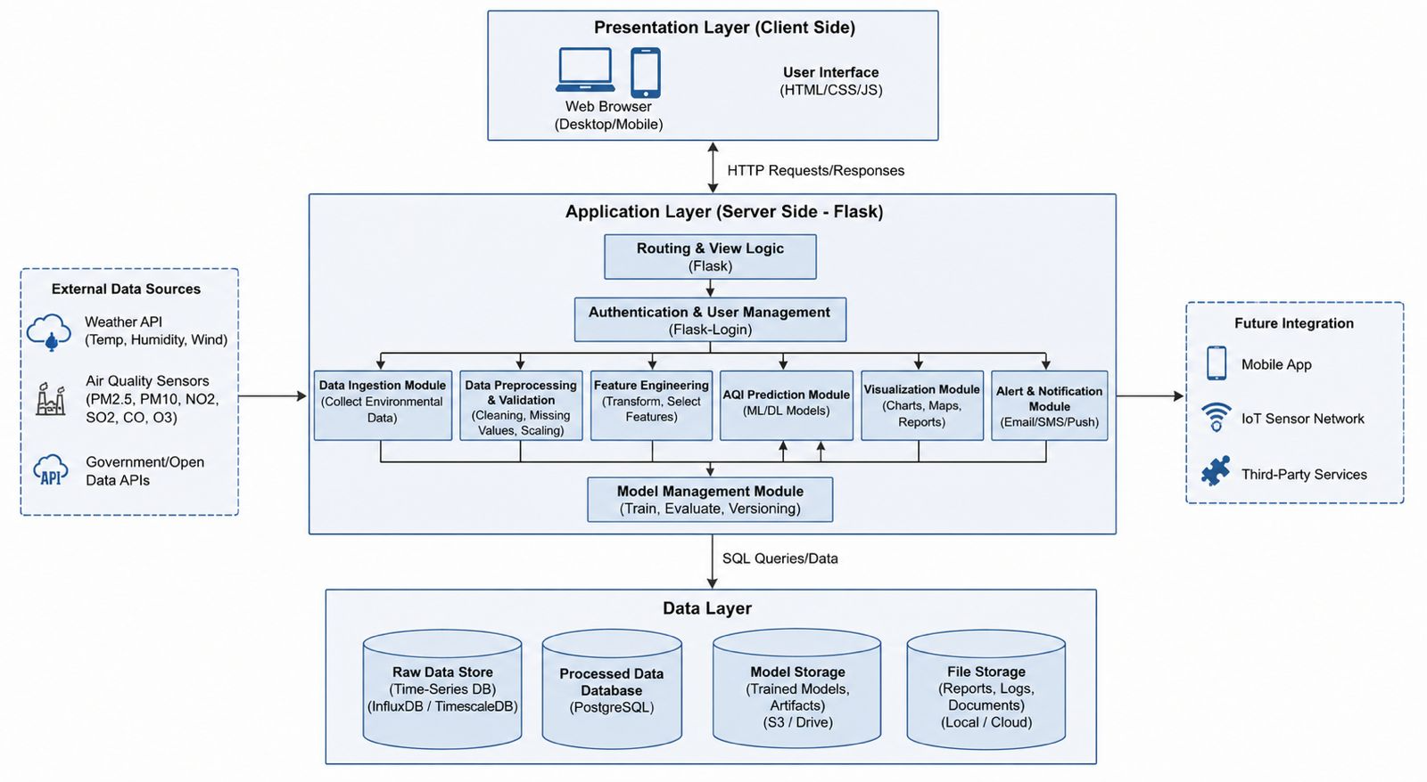
System Architecture

Slide 8
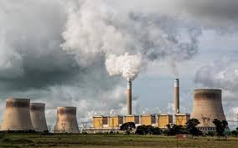
MODULE 1: Pollution Data Collection
Collects environmental datasets.
Gathers pollution parameters.
Stores historical pollution data.
Collects:
PM2.5
PM10
Temperature
Humidity
CO₂
NO₂

Slide 9
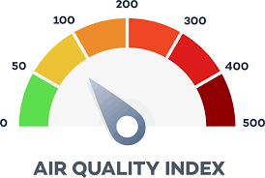
MODULE 2: Air Quality Analysis
Cleans pollution data.
Removes missing values.
Performs feature extraction.
Analyzes pollution trends.
Visualizes AQI patterns.
Identifies environmental changes.

Slide 10
MODULE 3: AQI Prediction
Predicts future AQI levels.
Uses trained AI models.
Applies Random Forest algorithm.
Applies LSTM algorithm.
Generates accurate AQI forecasts.

Slide 11
Conclusion
AQI prediction system was developed successfully.
Environmental data analytics improved monitoring.
LSTM and Random Forest enhanced prediction accuracy.
System supports pollution control activities.
Useful for smart city applications.

Slide 12
References
Hameed, S., Islam, A., Ahmad, K., Belhaouari, S. B., Qadir, J., & Al-Fuqaha, A. (2023). Deep learning based multimodal urban air quality prediction and traffic analytics. Scientific Reports, 13(1), 22181.
Osman, N., Jamlos, M. F., Dzaharudin, F., Khan, A. R., Yeow, Y. K., & Khairi, K. A. (2021). Real-time and predictive analytics of air quality with iot system: A review. Recent Trends in Mechatronics Towards Industry 4.0: Selected Articles from iM3F 2020, Malaysia, 107-116.
Hamza, M. A., Shaiba, H., Marzouk, R., Alhindi, A., Asiri, M. M., Yaseen, I., ... & Rizwanullah, M. (2022). Big Data Analytics with Artificial Intelligence Enabled Environmental Air Pollution Monitoring Framework. Computers, Materials & Continua, 73(2).
Iskandaryan, D., Ramos, F., & Trilles, S. (2020). Air quality prediction in smart cities using machine learning technologies based on sensor data: a review. Applied Sciences, 10(7), 2401.
Shah, S., Patel, Y., Panchal, K., Gandhi, P., Patel, P. and Desai, A., 2021, April. Python and MySQL based smart digital retail management system. In 2021 6th International Conference for Convergence in Technology (I2CT) (pp. 1-6). IEEE.
AMURU, I. and Dzikrillah, A.R., 2024. Database-Based Gui System To Increase The Effectiveness Of Student Data Management In The Fkip Uhamka Dormitory. Jurnal Teknik Informatika (Jutif), 5(4), pp.21-31.

Slide 13


